Slide 1

Shablonlashtirish

Slide 2
View
View – Serverdan foydalanuvchiga qaytariladigan javob. Odatda HTML ko'rinishda bo'ladi. Laravelda View uchun Blade shablonizatordan foydalaniladi. Kontrollerda view faylni qaytarish uchun view() metodidan foydalaniladi, metodning birinchi parametric view nomi, ikkinchi parametri unga jo'natiladigan qiymatlar va nomlari.
Route::get('/', function () {
return view('greeting', ['name' => 'James']);
});
Ushbu qaytadigan javob uchun resources/views/greeting.blade.php fayli yaratilishi kerak. Faylning taxminiy tarkibi quyidagicha bo'lishi mumkin:
<html>
<body>
<h1>Salom, {{ $name }}</h1>
</body>
</html>
{{ $name }} – serverdan view metodi qaytargan massivning kaliti blade faylda o'zgaruvchi sifatida ishlatiladi.
use Illuminate\Support\Facades\View;
… return View::make('greeting', ['name' => 'James']);

Slide 3
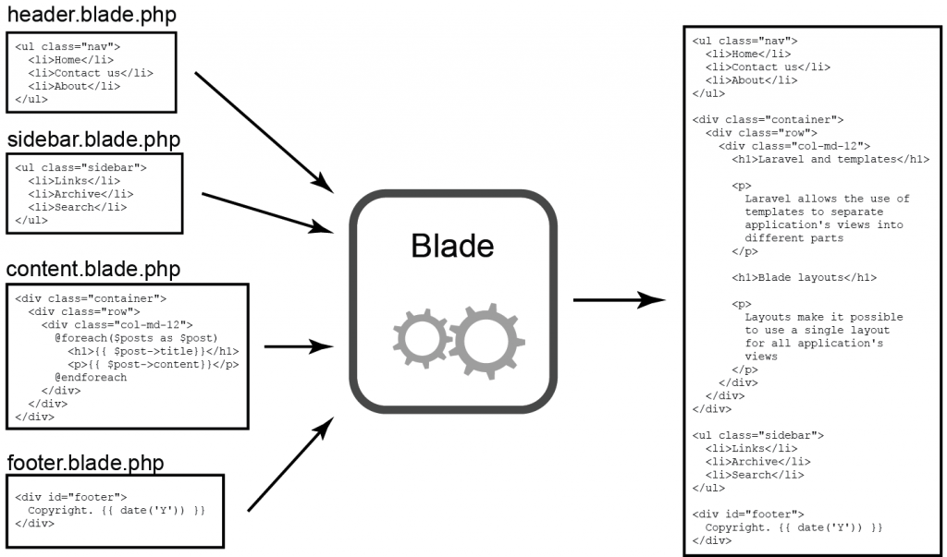
Blade
Blade – Laravel tarkibiga kiruvchi shablonlar boshqaruvchisi.

Slide 4
Kontrollerga qiymat jo'natish usullari
1. return view('web.home', ['name' => 'James', 'city' => 'London']);
2. $city = 'London';
return view('web.home')->with('name', 'James')->with('city' => $city);
3. $name = 'James';
$city='London';
return view('web.home', compact('name', 'city'));
Uchchala holatda ham resources/views/web/home.blade.php fayli yaratilishi kerak.

Slide 5
View Share
View::share berilganlarni barcha shablonlarda ishlatish imkonini beruvchi metod. Odatda App\Providers\AppServiceProvider ning boot metodi orqali chaqiriladi (yoki maxsus servis provayder yaratiladi).
<?php namespace App\Providers;
use Illuminate\Support\Facades\View;
class AppServiceProvider extends ServiceProvider
{
// …
public function boot(): void
{
View::share('key', 'value123');
}
}
<!DOCTYPE html>
<html lang="en">
<head>
<title>Document</title>
</head>
<body>
Salom
{{ $key }}
</body>
</html>

Slide 6
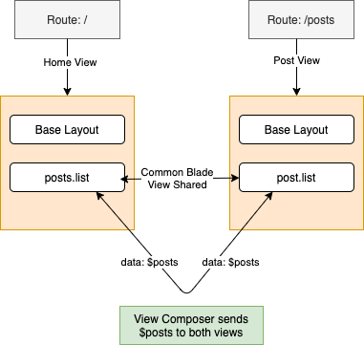
View Composer
View Composer – shablon taqdim etilganda chaqiriladigan callback metod yoki sinf metodi.
View Composer servis provayderda ro'yxatdan o'tishi kerak:
php artisan make:provider ViewServiceProvider
Yaratilgan provayderni ham ro'yxatdan o'tkazish kerak. Buning uchun config/app.php faylda provayderlar ro'yxatiga qo'shish kerak:
'providers' => [
// …
/*
* Application Service Providers...
*/
App\Providers\ViewServiceProvider::class
],

Slide 7
View Composer
ViewServiceProvider fayli kodi:
<?php namespace App\Providers;
use Illuminate\Support\Facades;
use Illuminate\Support\ServiceProvider;
use Illuminate\View\View;
use App\View\Composers\MenuComposer;
class ViewServiceProvider extends ServiceProvider
{ public function boot(): void
{
// Sinf orqali composer...
Facades\View::composer('menu', MenuComposer::class);
// Closure metodli composer...
Facades\View::composer('welcome', function (View $view) {
// ...
});
}
}

Slide 8
View Composer
Ma'lumotni taqdim qiluvchi sinfda compose metodi ishga tushuvchi metod (App\View\Composers\MenuComposer.php faylidas):
<?php
namespace App\View\Composers;
use App\Repositories\StudentRepository;
use Illuminate\View\View;
class MenuComposer
{
protected $menus;
public function __construct(protected StudentRepository $students)
{
$this->menus = [
['link' => 'http://kiut.uz', 'text' => "KIUT"],
['link' => 'http://edu.uz', 'text' => "EDU.UZ"],
['link' => 'http://ise.uz', 'text' => "ISE"],
];
}
public function compose(View $view): void
{
$view->with('count', $this->students->count())->with('menus', $this->menus);
}
}
views\menu.blade.php faylida:
@foreach ($menus as $menu)
<li><a href="{{ $menu['link'] }}">{{ $menu['text'] }}</a></li>
@endforeach
Chaqirish uchun boshqa blade fayllarda:
@include('menu')

Slide 9
View
ViewComposerlarni bir nechta shablon fayllarga biriktirish mumkin:
use App\Views\Composers\MultiComposer;
use Illuminate\Support\Facades\View;
…
View::composer(
['profile', 'dashboard'],
MultiComposer::class
);
Kelishuv bo'yicha Blade shablon fayllar kompilyatsiya qilinadi (Laravel tekshiradi va o'zgartirish kiritilgan bo'lsa qayta kompilyatsiya qiladi). Bu samaradorlikka ta'sir qiladi. Oldini olish uchun oldindan kompilyatsiya qilib qo'yish mumkin:
php artisan view:cache
Yoki keshni tozalash mumkin:
php artisan view:clear

Slide 10
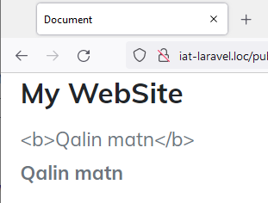
Blade va o'zgaruvchilar
{{ }} orqali chop qilishda Blade avtomatik ravishda htmlspecialchars funksiyasi orqali jo'natiladi, bu XSS-hujumlarning oldini oladi.
Agar chop qilinayotgan ma'lumotlar ekranlashtirilishini bekor qilish zarur bo'lganda {!! !!} ishlatiladi:
Salom, {!! $name !!}.
public function index()
{
$matn = "<b>Qalin matn</b>";
return view('home.index', ['matn' => $matn]);
}
--------------------------------------------------------------------------------------------------------
<div>{{ $matn }}</div> <div>{!! $matn !!}</div>

Slide 11
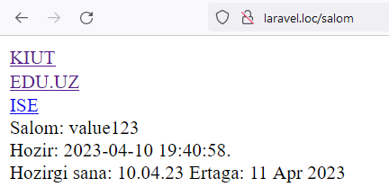
Blade
Chop qilinuvchi ma'lumotlar faqat o'zgaruvchi bo'lishi shart emas:
Hozir: {{ now() }}. <br>
Hozirgi sana: {{ now()->format("d.m.y") }}
Ertaga: {{ Carbon\Carbon::parse(now(), 'YYYY-MM-DD HH:mm:ss')->addDays()->format('d M Y') }}

Slide 12
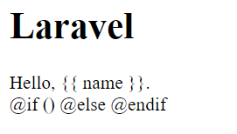
Blade
Chop qilinuvchi ma'lumotlar belgisi yoki Blade direktivalari oldidan @ belgisini qo'yish orqali undan keyingi yozuvlarni qayta ishlamaslik buyrug'ini berish mumkin:
Hello, @{{ name }}.
@@if()
Agar bunday shaklda yoziluvchi ma'lumotlar ko'p bo'lsa maxsus verbatim direktivasidan foydalanish mumkin:
<h1>Laravel</h1>
@verbatim
<div class="container">
Hello, {{ name }}.
</div>
@if ()
@else
@endif
@endverbatim

Slide 13
Blade direktivalari – shart
Shart direktivalari quyidagi ko'rinishda ishlatiladi:
@if (count($records) === 1)
I have one record!
@elseif (count($records) > 1)
I have multiple records!
@else
I don't have any records!
@endif
Maxsus autentifikatsiya direktivalari ham mavjud:
@auth
// Autentifikatsiyadan o'tganlar uchun...
@endauth
@guest
// Autentifikatsiyadan o'tmaganlar uchun...
@endguest
@switch($i)
@case(1)
First case...
@break
@case(2)
Second case...
@break
@default
Default case...
@endswitch

Slide 14
Blade direktivalari – takrorlash
Blade faylda takrorlash direktivalari muhim o'rin tutadi. Quyidagi ko'rinishlari mavjud:
@for ($i = 0; $i < 10; $i++)
The current value is {{ $i }}
@endfor
@foreach ($users as $user)
<p>This is user {{ $user->id }}</p>
@endforeach
@forelse ($users as $user)
<li>{{ $user->name }}</li>
@empty
<p>No users</p>
@endforelse
@while (true)
<p>I'm looping forever.</p>
@endwhile
@foreach ($users as $user)
@if ($user->type == 1)
@continue
@endif
<li>{{ $user->name }}</li>
@if ($user->number == 5)
@break
@endif
@endforeach
@foreach ($users as $user)
@continue($user->type == 1)
<li>{{ $user->name }}</li>
@break($user->number == 5)
@endforeach

Slide 15
Blade direktivalari – takrorlash
Takrorlash direktivalarida $loop o'zgaruvchisi mavjud va u bir qancha foydali xossalarga ega, ular quyidagilar:
Xossa | Ta'rifi
$loop->index | Takrorlashdagi joriy iteratsiya indeksi (0 dan boshlanadi).
$loop->iteration | Takrorlashdagi joriy iteratsiya (1 dan boshlanadi).
$loop->remaining | Takrorlashdagi qolgan iteratsiyalar.
$loop->count | Iteratsiya bo'layotgan massivning umumiy elementlar miqdori.
$loop->first | Takrorlashdagi birinchi iteratsiyaligini aniqlash.
$loop->last | Takrorlashdagi oxirgi iteratsiyaligini aniqlash.
$loop->even | Takrorlashdagi juft iteratsiyaligini aniqlash.
$loop->odd | Takrorlashdagi toq iteratsiyaligini aniqlash.
$loop->depth | Joriy takrorlashning darajasi.
$loop->parent | Ichki takrorlashda bo'lganda tashqi takrorlash o'zgaruvchisi.

Slide 16
Blade direktivalari
PHP kodlarni to'g'ridan to'g'ri ishlatish uchun:
@php
$counter = 1;
@endphp
Izohlar uchun quyidagicha ishlatiladi:
{{-- Bu yerda izoh mavjud --}}

Slide 17
Blade direktivalari – css sinflar
@class direktivasi yordamida shartlar asosida css-sinflar qurilishi mumkin.
@php
$isActive = false;
$hasError = true;
@endphp
<span @class([ 'p-4' , 'font-bold'=> $isActive,
'text-gray-500' => ! $isActive,
'bg-red' => $hasError,
])></span>
<span class="p-4 text-gray-500 bg-red"></span>

Slide 18
Avlod shablonlarni ulash
@include direktivasi shablonga boshqa shablonlarni ulash uchun ishlatiladi.
<div>
@include('shared.errors')
<form>
<!-- Form Contents -->
</form>
</div>
@include('view.name', ['status' => 'complete']) – parameter bilan
@includeIf('view.name', ['status' => 'complete']) – agar shablon mavjud bo'lmasa ham ishlaydi
@includeWhen($boolean, 'view.name', ['status' => 'complete'])
@includeUnless($boolean, 'view.name', ['status' => 'complete'])
@includeFirst(['custom.admin', 'admin'], ['status' => 'complete'])

Slide 19
Komponentlar
Komponentlar – shablonning qismlarini yaratishning usullaridan biri.
Artisan buyruq orqali yaratish:
php artisan make:component Alert
php artisan make:component Forms/Input
Bunda app/View/Components papkasida componentni va resources/views/components papkasidan uning shablonini yaratadi.
Anonim component yaratish uchun --view atributini (bayrog'ini) o'rnatish zarur:
php artisan make:component forms.input --view
Bunda faqatgina resources/views/components/forms/input.blade.php fayli yaratiladi.
Komponentlarni <x-component-nomi /> ko'rinishida ishlatish mumkin (kebab-case ishlatiladi), papkalarni ichiga . belgisi bilan kiriladi.
Odatda komponentlar servis provayderda boot() metodida ro'yxatdan o'tkazish kerak:
Blade::component('package-alert', AlertComponent::class);
Va uni ishlatish mumkin: <x-package-alert />

Slide 20
Komponentlar
Komponentga ma'lumot jo'natish uchun Blade componentda HTML atributlar orqali amalga oshiriladi. Agar PHP ifoda jo'natish kerak bo'lsa atribut oldidan : belgisi qo'yiladi. Ular komponentning render metodida qayta ishlanadi va view faylda chop qilinadi.
<x-alert type="error" :message="$message" />
Komponent:
<?php
namespace App\View\Components;
use Closure;
use Illuminate\Contracts\View\View;
use Illuminate\View\Component;
class Alert extends Component
{
public function __construct(public string $type, public string $message)
{
//
}
public function render(): View|Closure|string
{
return view('components.alert');
}
}
Komponentning blade fayli:
<div class="alert alert-danger {{ $type }}">
{{ $message }}
</div>

Slide 21
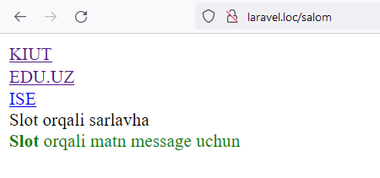
Slot
Komponentga qo'shimcha ma'lumotlarni jo'natish zarur bo'lganda maxsus $slot o'zgaruvchidan foydalanish mumkin.
<!-- /resources/views/components/alert.blade.php -->
<span class="alert-title">{{ $title }}</span>
<div class="alert alert-danger {{ $type }}">
{{ $slot }}
{{ $message }}
</div>
Komponentni chaqirish
<x-alert type="info" message="message uchun">
<x-slot:title>
Slot orqali sarlavha
</x-slot>
<strong>Slot</strong> orqali matn
</x-alert>
https://laravel.com/docs/10.x/blade#components

Slide 22
Maketlar qurish
1. Komponentlar orqali qurish usuli.
1.1. Maketni aniqlab olish:
<!-- resources/views/components/layout.blade.php -->
<html> <head>
<title>{{ $title ?? 'Student App' }}</title>
</head> <body>
<h1>Student Project</h1>
<hr />
{{ $slot }}
</body> </html>
1.2. Sahifaning blade fayli:
<!-- resources/views/students.blade.php -->
<x-layout>
<x-slot:title>
Ko'rsatmasa default oladi
</x-slot>
@foreach ($students as $student)
<li>{{ $student['name'] }}</li>
@endforeach
</x-layout>

Slide 23
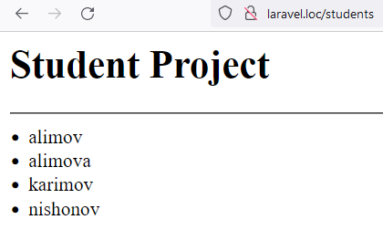
Maketlar qurish
1. Komponentlar orqali qurish usuli.
1.3. Route fayli:
use App\Http\Controllers\StudentController;
Route::get('students', [StudentController::class, 'index']);
1.3. Route fayli:
class StudentController extends Controller
{
protected $students;
public function __construct(StudentRepositoryInterface $students)
{
$this->students = $students;
}
public function index()
{
$students = $this->students->allStudents();
return view('students', compact('students'));
}

Slide 24
Maketlar qurish
2. Shablonlardagi vorislik orqali.
2.1. Maket faylini qurish:
<!-- resources/views/layouts/app.blade.php -->
<html>
<head>
<title>App Name - @yield('title', 'Default')</title>
</head>
<body>
@section('sidebar')
This is the master sidebar.
@show
<div class="container">
@yield('content')
</div>
</body>
</html>

Slide 25
Maketlar qurish
2. Shablonlardagi vorislik orqali.
2.2. Maketni kengaytirish:
<!-- resources/views/child.blade.php -->
@extends('layouts.app')
@section('title', 'Page Title')
@section('sidebar')
@parent
<p>This is appended to the master sidebar.</p>
@endsection
@section('content')
<p>This is my body content.</p>
@endsection

Slide 26
Maketlarda statik fayllardan foydalanish
Maketda .css va/yoki .js fayllarni ulash uchun asset() helper funksiyasidan foydalanish mumkin. Bunda fayllar /public papkada joylashgan bo'lishi kerak:
<link href="{{ asset('css/styles.css') }}" rel="stylesheet">
<script type="text/javascript" src="{{ asset('js/scripts.js') }}"></script>
Yoki mix() metodidan foydalanish mumkin (bunda NodeJS o'rnatilgan bo'lishi kerak, https://laravel.com/docs/10.x/mix)
<link href="{{ mix('css/styles.css') }}" rel="stylesheet">
<script type="text/javascript" src="{{ mix('js/scripts.js') }}"></script>

Slide 27
Savollar?

